Slide 1
Cybersecurity
Jesse Villanueva, Hayden Flagg, Pierce Peterson, and Anthony Quintero
Advisor: Dr. Cavalcanti
Notes:
Hello Everybody. For our project we chose the subject of cybersecurity.

Slide 2
Introduction
Anthony Quintero
Two servers, Sad Server and the Good Server
Sad Server is meant to be vulnerable
Good Server is meant to be secure and impenetrable
We developed SQL Injections to penetrate
Notes:
We planned to make two websites/servers. One server, the Sad Server, is meant to be vulnerable to cyber-attacks allowing us to hack it using methods like SQL Injection and DDOS attacks. The second server, the Good Server, is supposed to be an improvement on the Sad Server. It is meant to be safe, secure, and impenetrable. We developed an Extension that includes multiple SQL Injections to hack the Sad Server

Slide 3
Sad Server
Locally hosted - http://capstone.retrop.net/
Uses PHP, HTML, CSS and SQL
Meant to be vulnerable
Notes:
The sad server is Locally hosted on Jesse’s PC. PHP is used for the login and signup features to access our database and sql is what we used for our database. This sad server is meant to be vulnerable to hacking like sql injections.

Slide 4


Pierce Peterson
What is a SQL Injection?
SQL injection is a technique used to insert malicious SQL statements within an execution field in order to target data.
Web hacking technique used to target poorly design websites.
Using a bit of spoofed statements allows users to enter in their own queries and allows them to control the database without actual access to it.
Ex. When asking for a password and username the sites creator is intentionally giving any user 3rd party access to the site’s database using automated queries.

Slide 5
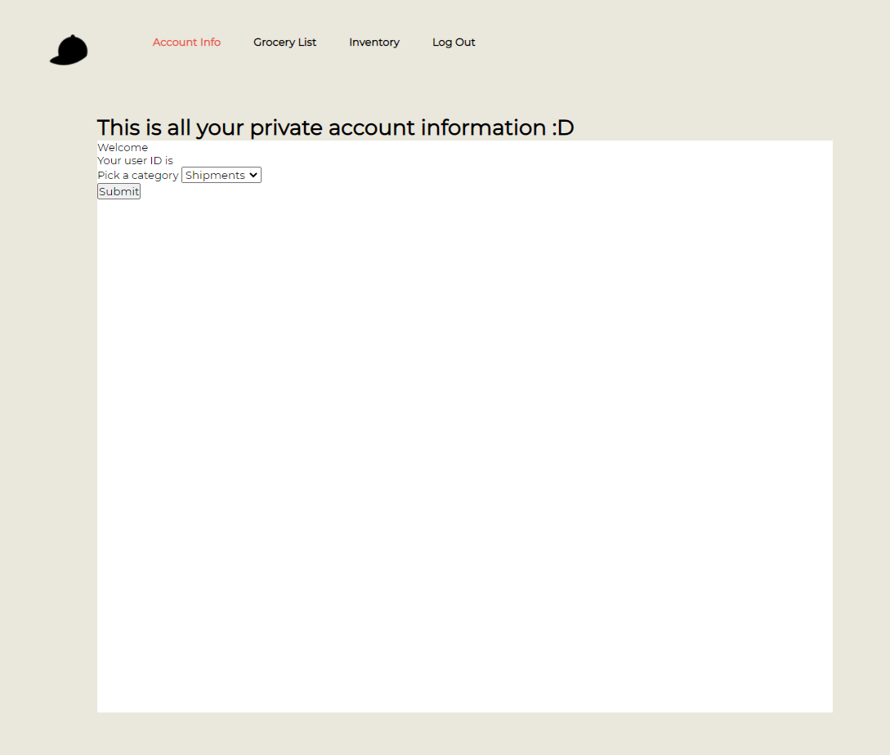
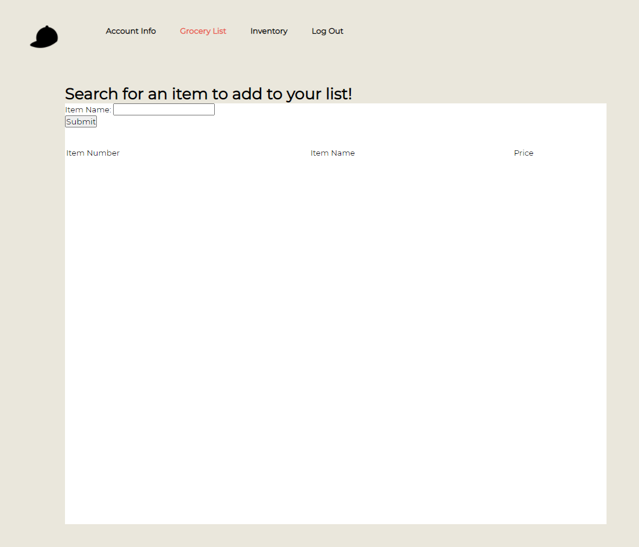

Pierce Peterson
Notes:
While it’s not very feasible to develop such a tool on a modern day website due to advanced security measures or the fact we are trying develop a tool that lies within the grey area of one of the top cyber crimes listed under the Computer Fraud and Abuse Act (CFAA) United States cybersecurity bill that was enacted in 1986. We decided to create our own site that allows us to tamper with in any shape or capacity. While the site itself is not close to professional grade standards or procedures it’s enough to demonstrate the concept of the overall goal of the project. Created in with HTML5 and a mix of PHP with a mySQL database we had a functioning website that allowed us to try and manipulate table data.

Slide 6
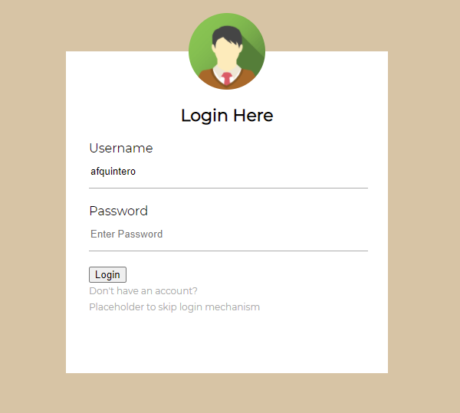
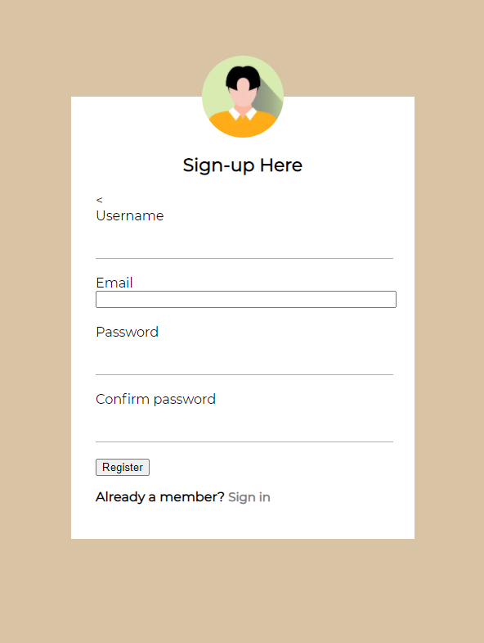
Sad Server - Login/Sign Up Pages
Asks for Username/Password
Link to Sign Up page
Can skip sign up
Asks for Username/Password/Email
Also supplies a link back to the Login page.
Will add details to our database
Notes:
Login page is the first page new visitors will see. It allows previous users to login and new users to access the sign up page. For ease of use we’ve also included a skip login link to go to the account page. The sign up page is similar to our login, it asks for your username password and email. Once you click register it will save your acct details to our database. If you already ahve an account you can click the link at the bottom to go back to our login page.

Slide 7
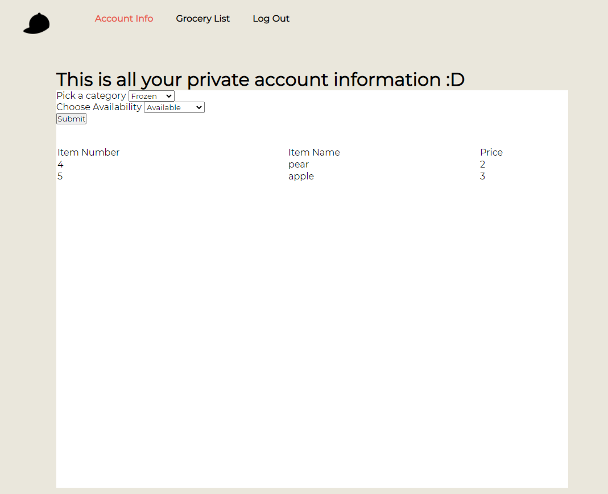
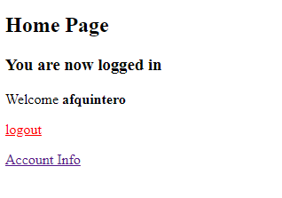
Sad Server - Index/Account Pages
After you login/sign up
Lets you know login was successful
Server will keep you logged in if it was recent
Notes:
Once you login or sign up you will be taken to our Index/Home Page. it will let you know you successfully logged in and you can then logout or access our account info page. If you had logged in recently, you will be taken straight to the index page skipping the login and sign pages. On our account page we have a list of available products organize din the drop down window by produce and frozen

Slide 8
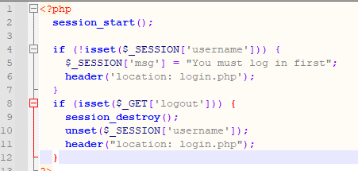
Sad Server - Back End
Anthony Quintero
Our server makes use of Sessions.
session_start() - A way to store information across pages
Similar to cookies
Notes:
When you first access the Sad Server Index.php will check if you have recently logged into the website, if so it will log you in. Our sad server does this through session_start() which starts a session. Sessions are a way to store information across pages similar to cookies but instead of storing the information on your computer like cookies it will instead store it on our server temporarily. If there is no recent session then you will be redirected to the login page

Slide 9
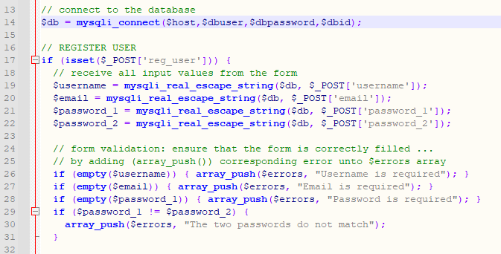
Server.php
Anthony Quintero
All our php files include server.php
server.php is our connection to our databases
login.php and signup.php let server.php do the heavy lifting
Notes:
Server.php handles the backend of the server, it is our connection to our databases. When you try to login on the login.php, server.php will check our user table for your username and password, if both are found then you will be successfully logged in and these credentials will be added to your session. If your signing up server.php will add your username, password, and email to our user database. It will then perform the same login steps

Slide 10
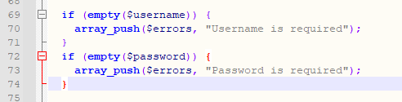
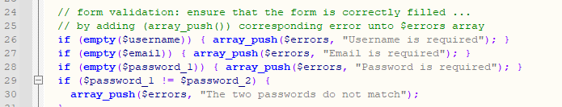
Error Handling
Anthony Quintero
Server.php also handles errors
Checks if your passwords are the same
Checks if you had input in all text fields
Notes:
Server.php also has error handling. On the login page this checks if your inputted both a password and username or if your password and username match to the same account
On our signup.php this checks to make sure the username you chose hasn’t already been used. It also makes sure you inputted in all fields including email and password. I tmakes sure you confirmed your chosen password a second time.

Slide 11
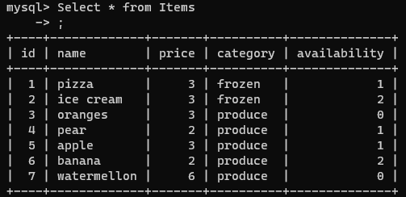
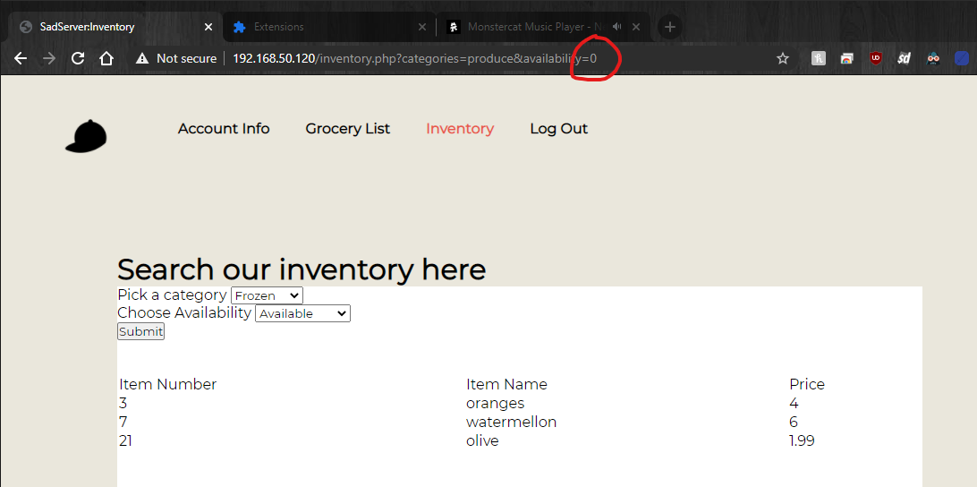
Exploit
Jesse Villanueva
SadServer uses the URI for the form submission.
Other values can be added to the URI which may be different from what is normally allowed.
This SQL server uses an availability column for unreleased, available, out of stock.
Availability setting on the page only allows Available or Out of Stock.
Manually setting the availability to 0 allows user to view items they should not be able to see.
Notes:
The main exploit of the server is that it uses the get command in PHP to get the data for the query without processing the information first.
We chose to use the get command instead of the post command to make it more apparent in this demonstration and to allow ease of manipulation even without any special tools.
The attacks we do would still work with the post but it would require editing the HTML in the page, which we developed a chrome extension for.
This exploit can be seen in many ways, but what I have here on the screen is our inventory page. Normally you can only choose between frozen, produce, or grocery, and if the availability is available or out of stock. If we submit these queries we can notice Availability is set to 1 for available, and 2 for out of stock. But you can see in the table we also have 0, this is a way a website might store products that are not yet released for sale.
In the screenshot to the right we can see we can manually enter 0 into the URL bar and if we were to hit enter the query would grab that 0 and insert it into our query, giving us a list of all the unreleased items in the given category which we ordinarily should not be able to see.

Slide 12
Solutions to exploit
Jesse Villanueva
Avoiding URI for queries if possible
Taking the category from the fields directly can help prevent unwanted inputs.
Using lists can prevent unwanted inputs without use of console.
Filtering URI Input
URI info is taken before page is fully loaded
Filter before putting into query, not just the input fields.
Using better queries
Firebase queries are more robust allowing less need for filtering.
Notes:
There are a few ways we can mitigate the exploit.
The simplest is more of just a deterrent but it will make it less likely that one would notice you might be susceptible to attacks and that’s avoiding using the URI for queries. Since the URI is visible in most cases it is easy for people to notice, so using post which is similar to get, but doesn’t show in the URL bar can help hide what values you are using in your query.
On top of that it would be recommended to filter the information before creating the query. The query is ran by PHP so it is taken before web page fully loads. Adding a function in the PHP before the query that checks for special character like apostrophes or specific table names will aid in getting rid of queries you did not authorize.
An alternative option if you did not want to implement that yourself would be to use smarter queries. Firebase has a query system that is more robust and can’t be attacked in such ways.

Slide 13
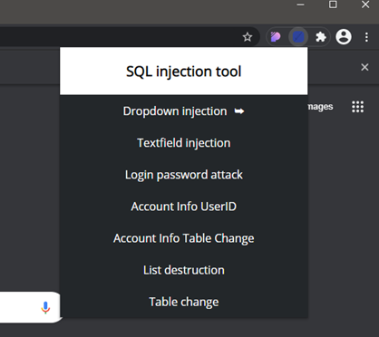
SQL Injection Extension
Jesse Villanueva
2 General attacks
5 Direct attacks for our sites
Manipulates DOM of current tab
Full descriptions on GitHub
Notes:
As I mentioned before we developed an extension to automate some of the manipulations our server is vulnerable to.
The first two commands are general use, these can be used on sites that have similar vulnerabilities to ours.
The next five are all attacks made specifically to showcase the data you can get out of our website by manipulating the query. They target parts of the DOM that are related to the query allowing us access to data we should not be able to access.
We have documented all of the commands on our github in the sqlextension folder if you are interested in exactly what each command does, but these are also showcased in the video demonstration.

Slide 14
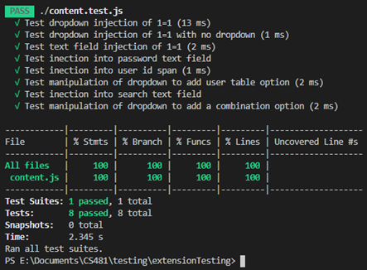
Testing the Extension
Jesse Villanueva
Manual testing was done in Chrome and Edge for compatibility
Written in Javascript
All functions manipulate DOM
Jest allows building of DOM
Jest reports any untested lines of code
Notes:
We tested our on both Google Chrome and Microsoft Edge, but it should work on any chromium based browser.
Testing of all JavaScript methods was done using Jest within VSCode. Jest was used as it allowed us to test the main feature of the extension, which is DOM manipulation. Each test generates the respective tag and then runs the command. After the command is ran, it checks to make sure the injection into the DOM works.
After all tests are ran we end up with a report that tells us all that was tested, and how much we did not test. This report is also available to view on our github in the automated testing portion of the testing repository on our GitHub.

Slide 15
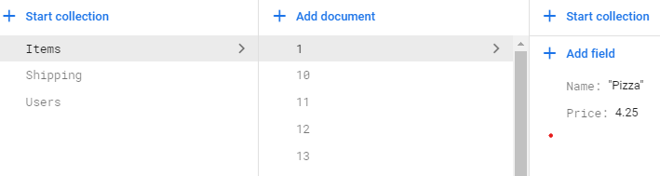
Good Server - Firebase Hayden Flagg
•Uses a third-party source to emulate our good server.
•Contains our database full of user information and items in our store.
•Firebase is also used to host the good server version of our website and can be visited at https://store-16edf.web.app/
•An advantage is that it’s protected against cyber attacks that our other server may not be protected against.

Slide 16
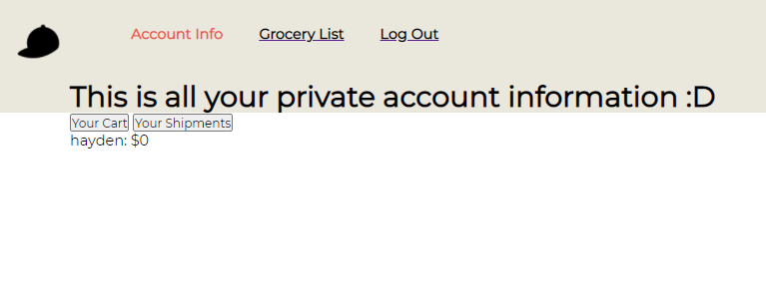
Good Server - Languages Hayden Flagg
•HTML & CSS
This makes up the body of the website
•JavaScript
Retrieves data from our server and displays the needed data onto the website
The JS interacts with our database through firebase.

Slide 17
Why is it more secure? Hayden Flagg
SQL injection
Firebase doesn’t use sql or php to create and manipulate its database, this makes SQL injection useless against it because the rules for SQL injection won’t apply, you can’t just change the URl
Injection
Firebase is run by another more professional party with more protections and regulations
This prevents users from manipulating data with other type of commands

Slide 18
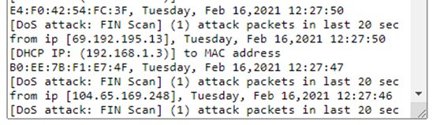
Why is it more secure? Cont. Hayden Flagg
Less input
The happy server website allows for less input
This makes it harder for attackers to manipulate our data.
DDOS
Firebase is run by another more professional party with more protections and regulations on what goes through the database
Firebase can handle more simultaneous inputs than our other server can

Slide 19
Conclusion Hayden Flagg
Two servers
More robust server is better/more secure
Better against injections
Better against attacks

